Slide 1
A classification and literature survey on AI-powered Nutrition Analyzer
Project Mentor :
Mr. A. Gopinath
Team id : PNT2022TMID23229
Team Members:
Jeyaroshini L S S
Jeyasree P V
Madhuvarshni C
Felcia Liganz Deshna B
Department of Information Technology
Velammal College of Engineering and Technology

Slide 2
Contents
Abstract
Problem definition
Survey Papers
Existing Application
Hardware & Software Requirements
Objective
Department of Information Technology
Velammal College of Engineering and Technology

Slide 3
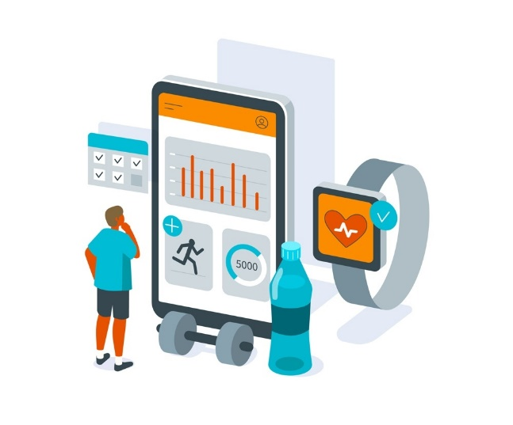
Abstract
An artificial intelligence application in the field of nutrition and dietetics is a fairly new and important field. The importance of individual nutrition has also triggered the increase in artificial intelligence applications. It is thought that different routes such as food preferences and dietary intake can play an important role in health promotion. Some applications used in the assessment of food consumption contribute to overcoming these difficulties. Besides, these apps facilitate the work of researchers and provide more reliable results than traditional methods.
Department of Information Technology
Velammal College of Engineering and Technology

Slide 4
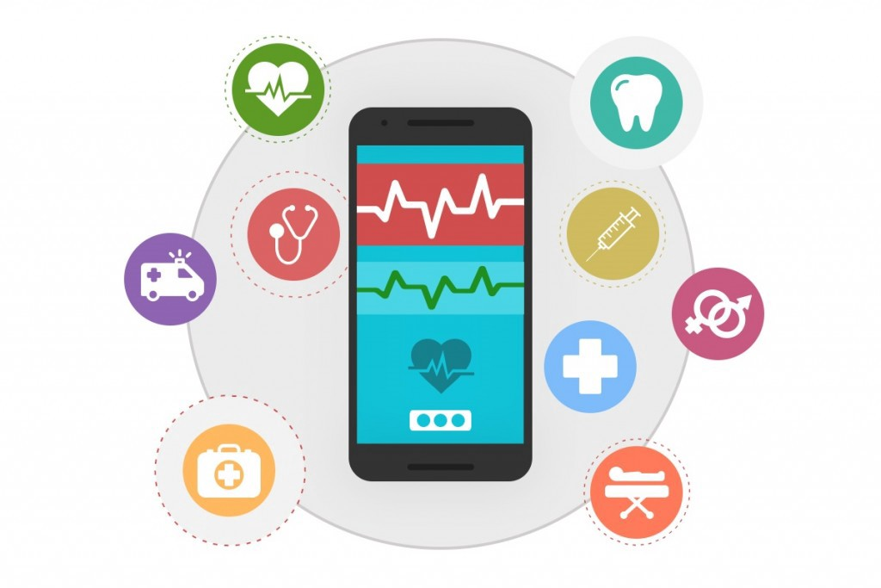
Problem Definition
To build an AI-powered Nutrition Analyzer for Fitness Enthusiasts which acts as a diet consultant similar to a real dietician.
To provide multiple diet plans, workouts, and keep track of the person’s fitness.
Department of Information Technology
Velammal College of Engineering and Technology

Slide 5
Survey Papers 1
Author Name : Sofia Balula Dias
Title: Users' Perspective on the AI-Based Smartphone PROTEIN App for Personalized Nutrition and Healthy Living
Publication website : https://www.frontiersin.org/articles/10.3389/fnut.2022.898031/full
Published Date : 01 July 2022
Objective : Aims to analyze the nutrition intake of individuals.
Technology used:
AI: To propose advice on personalized meal plans and physical activities.
Deep learning: To generate/update recommendations for the user’s dietary intake.
Department of Information Technology
Velammal College of Engineering and Technology

Slide 6
Survey Papers 2
Author Name : Chang Liu
Title: A New Deep Learning-based Food Recognition System for Dietary Assessment on An Edge Computing Service Infrastructure
Publication website : https://ieeexplore.ieee.org/document/7837725
Published Date : 31 January 2017
Objective : To develop a practical deep learning based food recognition system for dietary assessment within the edge computing service infrastructure.
Technology used: Object Recognition, Deep Learning, Edge Computing
Department of Information Technology
Velammal College of Engineering and Technology

Slide 7
Survey Papers 3
Author Name : DiFilippo KN
Title: The use of mobile apps to improve nutrition outcomes
Publication website : https://pubmed.ncbi.nlm.nih.gov/25680388/
Published Date : 12 Feb 2015
Objective : To develop a practical deep learning based food recognition system for dietary assessment within the edge computing service infrastructure.
Technology used: Deep learning, Edge Computing
Department of Information Technology
Velammal College of Engineering and Technology

Slide 8
Survey Papers 4
Author Name : Alan Scarry
Title: Usage of Mobile Applications or Mobile Health Technology to Improve Diet Quality in Adults
Publication website: https://www.google.com/url?sa=t&rct=j&q=&esrc=s&source=web&cd=&cad=rja&uact=8&ved=2ahUKEwjdje23qJz6AhVhRmwGHY3OCqUQFnoECAsQAQ&url=https%3A%2F%2Fwww.mdpi.com%2F2072-6643%2F14%2F12%2F2437%2Fpdf&usg=AOvVaw23FTBnfWsXbJApr-hSBjpZ
Published Date :12 June 2022
Objective : Aims to explore mobile applications and their impact on the diet quality of the user Technology used: Mobile Health Technology
Department of Information Technology
Velammal College of Engineering and Technology

Slide 9
Survey Papers 5
Author Name : Karoline Villinger
Title: The effectiveness of app-based mobile interventions on nutrition behaviours and nutrition-related health outcomes
Publication website: https://doi.org/10.1111/obr.12903
Published Date : 28 July 2019
Objective : To assess the effectiveness of app-based mobile interventions for improving nutrition behaviours and nutrition-related health outcomes
Technology used: M-Health technology
Department of Information Technology
Velammal College of Engineering and Technology

Slide 10
De-merits
Drained battery
GPS problems
Internet Availability
Department of Information Technology
Velammal College of Engineering and Technology

Slide 11
Hardware & Software Requirements
Software Required :
Android SDK
Windows XP
Java JDK
Notepad
Micrsoft VS Code
System Required :
Hard Disk – 2 GB.
RAM – 1 GB.
Processor – Dual Core or Above.
Mouse.
Keyboard.
Monitor.
Department of Information Technology
Velammal College of Engineering and Technology

Slide 12
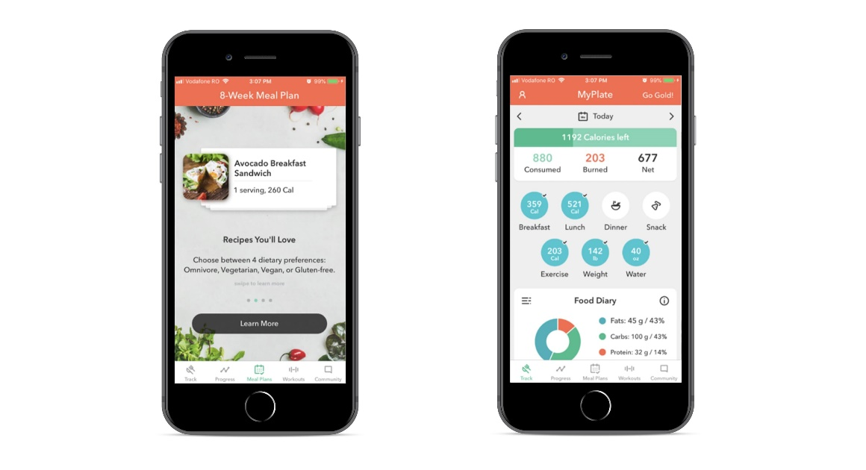
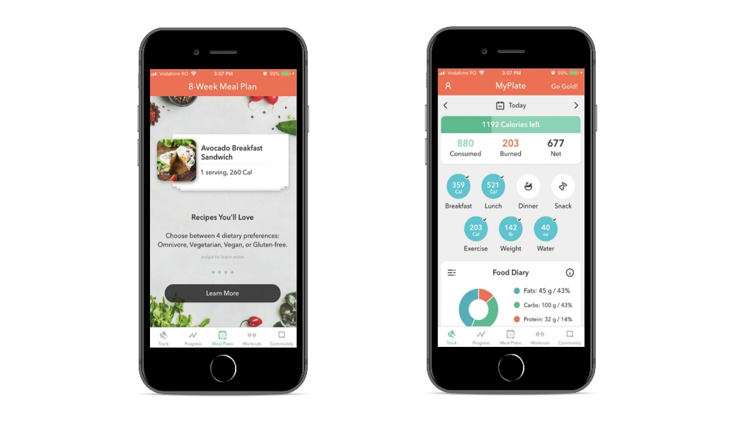
Objective
To build an AI-powered Nutrition Analyser for Fitness Enthusiasts which acts as a diet consultant similar to a real dietitian. A person in order to know his/her diet plan needs to give some information to the dietician such as its body type, weight, height and working hour details. Similar way this system also provides the diet plan according to the information entered by the user.
Department of Information Technology
Velammal College of Engineering and Technology

Slide 13
Thank You!
Department of Information Technology
Velammal College of Engineering and Technology

